Slide 1
AUDIO AND VIDEO STREAMING USING LI-FI
LI-FI THE FUTURE OF DATA TRANSMISSION

Slide 2

Presented by
M. S. PAVAN ADITYA(14981A0471) P. SIVA KRISHNA(14981A0470)
P. HEMANTH KUMAR(14981A0494) B. SRAVAN KUMAR(15985A0407)
Under the esteemed guidance of
Dr. CH. SRINIVASU, M. Tech, P. hD Professor
Department of ECE
RAGHU ENGINEERING COLLEGE (A) Accredited by NAAC with a grade ‘A’ and Accredited by NBA Dakamari, Bheemunipatnam(M),Visakhapatnam-531162 (2017-2018)

Slide 3
CONTENTS
ABSTRACT
INTRODUCTION
What is Li-Fi
Birth of Li-Fi
Issues of Wi-Fi
JUSTIFICATION OF PROJECT
Why only Li-Fi
OBJECTIVE AND SCOPE
PLAN OF PROJECT
MODEL OF THE PROJECT
ADVANTAGES, APPLICATIONS AND LIMITATIONS
REFERENCES

Slide 4
ABSTRACT
Li-Fi is a label for wireless-communication systems using light as a carrier instead of traditional radio frequencies, as in Wi-Fi. The voice, speech, video data information can be transmitted using Li-Fi technology with high data rates. This technology is named as Li-Fi transmission which stands for Light Fidelity. This invention can produce data rates faster than 10 Mega-Bits per second which is much more than that of an average broadband speed of Wi-Fi connection and Bluetooth. Wireless communication has become a basic utility in personal and business life such that it becomes a fundamental of our lives, and this type of communication theory uses the radio spectrum which have limitations, i.e. capacity, efficiency, availability and security. The defects of Wi-Fi technology gave birth to the concept of Li-Fi technology. Li-Fi can be defined as a light-based Wi-Fi. This technology mainly serves the purpose of transmitting data using retrofitting of LED bulbs that has high efficiency, durability and reliability. With the increasing popularity of solid state lighting devices, Visible Light Communication (VLC) properly known Li-Fi technology is globally recognized as an advanced and promising technology to realize short-range, high speed as well as large capacity wireless data transmission. In this project, prototype of real-time audio and video broadcast system using inexpensive commercially available light emitting diode (LED) lamps is being implemented, and also with LED arrays is capable in supporting light illumination, data broadcast as well as video and audio streaming. Lighting model within room environment is designed and simulated, which indicates close relationship between layout of light sources and distribution of illuminance. Later, after the implementation of the experimental setup is done, the results are evaluated using MATLAB software for conversion of the input data into its digital form and vice versa for its simulation on the hardware setup. The final objective of Li-Fi development is the application of off-the-shelf LEDs in home environment wireless network to satisfy the needs of both illumination and data transmission.
Key points: Wi-Fi, Li-Fi, VLC, LED, MATLAB, High speed data transfer.

Slide 5
INTRODUCTION
Li-Fi: Light Fidelity
What is Li-Fi ..?
Transfer of data using light as the medium is known as Li-Fi.
Unlike Wi-Fi which uses Radio Spectrum, Li-Fi uses visible light as
spectrum.
Data transfer is done by an LED fitted with a Transceiver circuit.
Now every light bulb will work as a hub for data transfer.
It is possible to encode data in the light by varying the rate at which
LED’s flicker on and off to give different strings of 1s and 0s.
Switching on and LED is a logical ‘1’, switching it off is a logical ‘0’.
This modulation is so fast that our naked eye cannot notice it.

Slide 6
Issues of Wi-Fi
Wi-Fi uses radio waves spectrum for transmitting the data.
Since this band is congested and it is of a small finite range its capacity leads to dry up.
Even though the demand for wireless network is increasing day by day the number of base stations available are limited.
The cost of installation of a base station and maintaining it at optimum temperatures is more expensive.
This technology even has lesser bandwidths with a lower factor of efficiency.
Its availability is limited and is less secure.
These all issues in radio spectrum laid path for opting a method using light spectrum.

Slide 7
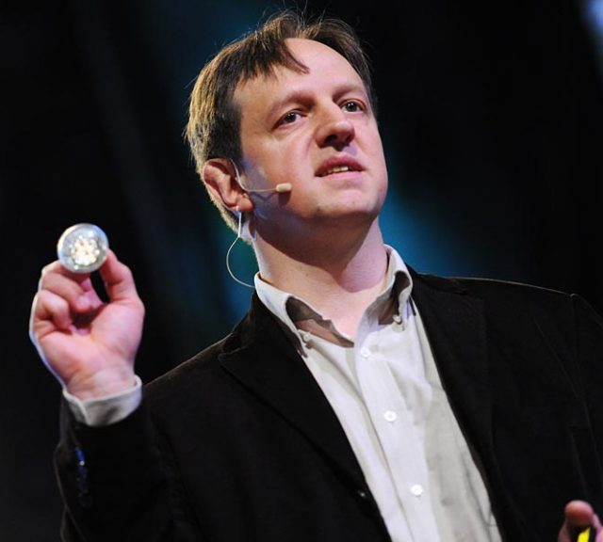
Birth of Li-Fi HARALD HAAS
Li-Fi was invented in late 1990’s in the countries
like Germany, Korea and Russia.
Then it was said to be called as Visible Light
Communication (VLC).
Later in 2011 Harald Hass Continued the work
on this technology and started integrating the
concept into an LED table lamp.
On 12th July 2011, at TED talks he demonstrated
the concept of Li-Fi on stage by transmitting a video through a table lamp
LED transceiver.
At present Li-Fi is being capable of transferring data a rate of 800 MB to more than 1 GB per second.

Slide 8
JUSTIFICATION OF THE PROJECT
Why only Li-Fi ..?
Even though Gama rays have higher frequency the visible rays, Gama rays cant be used as they could be dangerous.
X-rays also have similar health issues. They can also be harmful when our body is continuously exposed to them.
Ultraviolet light is good for place without people, but other wise they are extremely dangerous for the human body.
Infrared spectrum is avoided due to the cause of eye safety regulation, so they can only be used with low power.
The problems with radio Waves are mentioned prior.
So, the only spectrum which could provide a good transmission medium is the visible light spectrum.

Slide 9
OBJECTIVE AND SCOPE
Objective:
The objective of the project is to justify the title ‘Audio and video streaming using Li-Fi’.
Digitalising the Analog input and giving it to the LED lamp through the lamp driver circuit and reproducing it back at the receiver by using a photo diode sensor is the process implemented for it.
Scope:
A single LED or an array of LED’s can be used for transmission of the light waves in the circuit.
Other than hardware this can also be implemented in software by using the MATLAB tool.
The hardware setup uses ADC and DAC at the transmitter and receiver sections respectively.
In the MATLAB software, the input is converted to binary bits and it is coded to RGB spectrum for its transmission through the LED.

Slide 10
PLAN OF PROJECT
The circuit consists of two sections a transmitter and a receiver.
Both the sections will have circuit supporting the LED bulbs used as transceivers.
The Analog signal is sent as input and is converted to its digital form and is supplied to the LED bulb.
The LED bulb takes ‘1’ an the ON condition and ‘0’ as the OFF condition and flickers according to the digital form of the Analog input.
It modulates according to the input but these modulations are not visible for the human eye.
At the receiver, a photo diode is fitted and it receives the data. The digital data is amplified and converted to its original Analog form.
Using MATLAB, the input signal is taken as frames and is converted into binary bits, these binary bits are coded into RGB data and are fed to the LED bulb and the reverse is done at the receiver part.

Slide 11
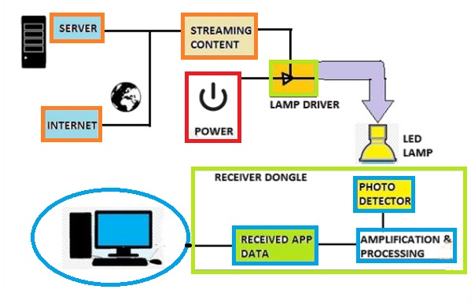
MODEL OF THE PROJECT
HOST
DATA
RECEIVED
DATA
CONVERSION AND AMPLIFICATION

Slide 12
Advantages, Applications and limitations
advantages
applications
limitations
Speed
Accessibility
Security
Doesn’t require separate routers
Safe and Eco-friendly
Conservation of energy
High efficiency
Schools, colleges and offices
In hospitals at OTs
Aircrafts
Underwater ROVs
Traffic signals and vehicular communications
Nuclear power plants
Limited to a single room
Cannot pass through opaque surfaces
Requires a compulsory line of sight

Slide 13
REFERENCES
Optics and Photonics Journal, 2013, 3, 153-157 doi:10.4236/opj.2013.32B037 Published Online June 2013 (http://www.scirp.org/journal/opj)
“Li-Fi (Light Fidelity)-The future technology In Wireless communication?” by Jyoti Rani. “Journal from International Journal of Applied Engineering Research” (IJAER); ISSN 0973-4562 Vol.7 No.11 (2012)
www.YouTube.com – TED Talk by Harald Hass on Li-Fi
International Journal for Trends in Engineering & Technology volume 23 issue 1 - May 2017 - ISSN: 2349 - 9303
https://www.cambridge.org/core/books/visible-light-communication/34CAFB565027F65A82C6E5E6E7A2989D
T. D. C. Little, P. Dib, K. Shah, N. Barra Ford and B. Gallagher, “Using LED Lighting for Ubiquitous Indoor Wireless Networking,” IEEE International Conference on Wireless and Mobile Computing, pp. 373-378, 2008. doi:10.1109/WiMob.2008.57
D. K. Son, E. B. Cho and C. G. Lee, “Demonstration of Visible Light Communication Link for Audio and Video Transmission,” Photonics Global Conference (PGC), pp.1-4-2010. doi:10.1109/PGC.2010.5706094
https://web.wpi.edu/Pubs/E-project/Available/E-project-032814-001416/unrestricted/MQP_Report_Final_Draft_3_27_14.pdf

Slide 14
THANK YOU
Presented by:
Pavan Aditya M S
Hemanth Kumar Patnala
P Siva Krishna
B Sravan Kumar

